Slide 1
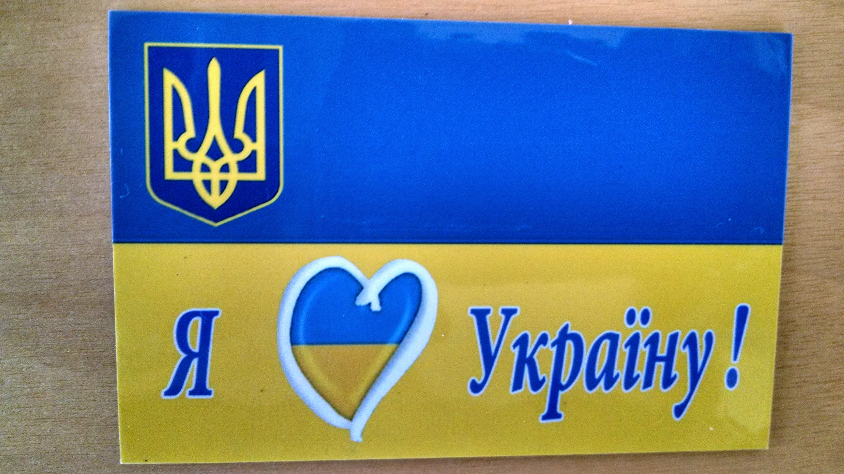

Slide 2
UKRAINE RESEARCH DIVISION of
JewishGen

Slide 3

Many Many Questions
What is the Ukraine Research Division
What do we do
How does it work
Who is involved
How can I be involved
What can I do to help
What can the Ukraine Research Division do for me
How can I find out what’s going on
What are plans and hopes for future work

Slide 4
CONTACT INFO
Towns Director: Chuck Weinstein Chuck1@outlook.com
Research Director: Phyllis Berenson PBerenson@jewishgen.org

Slide 5
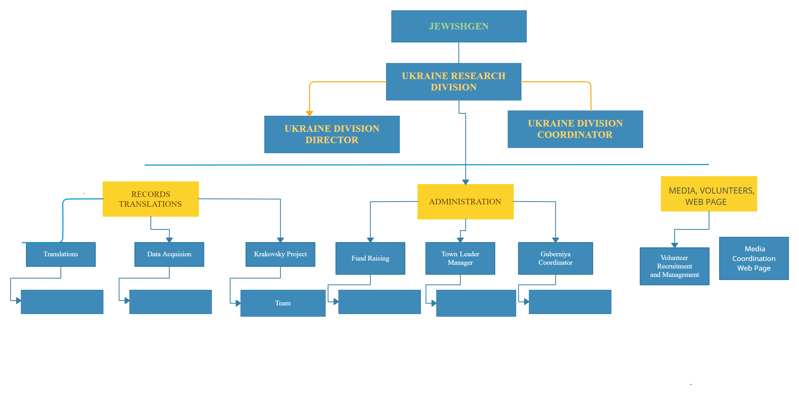
Ukraine Division RE Organization

Slide 6
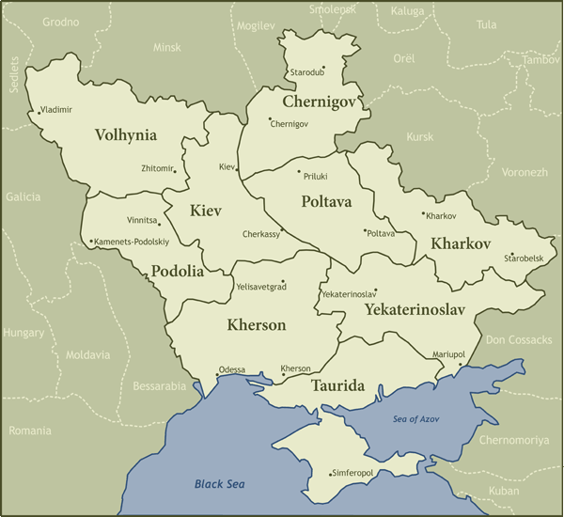

Slide 7
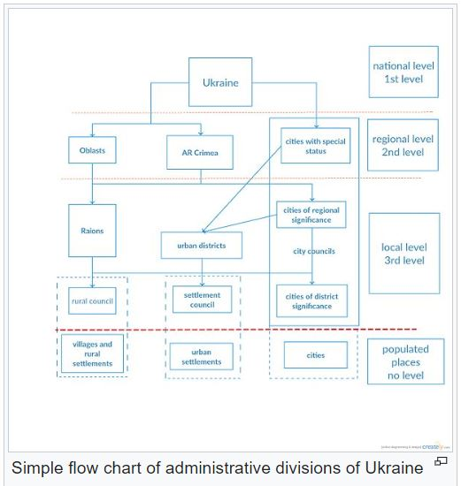

Slide 8
Identify Your Family’s Ukraine Towns
Sources:
JewishGen Ukraine Page:
Alphabetical List of Towns; also Lost Towns
Gazeteer
Routes to Roots Foundation:
rtrfoundation.org
Google
Archives and researchers in Ukraine

Slide 9
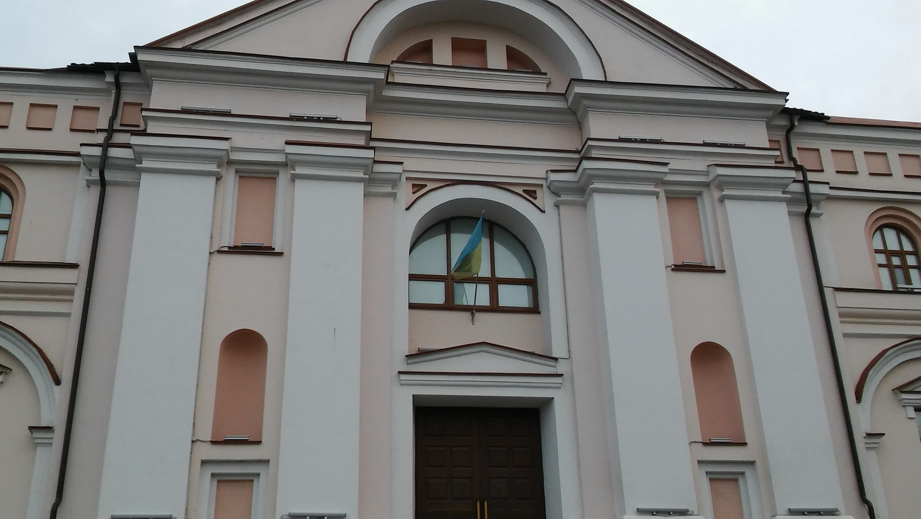
Vinnitsa Archive

Slide 10
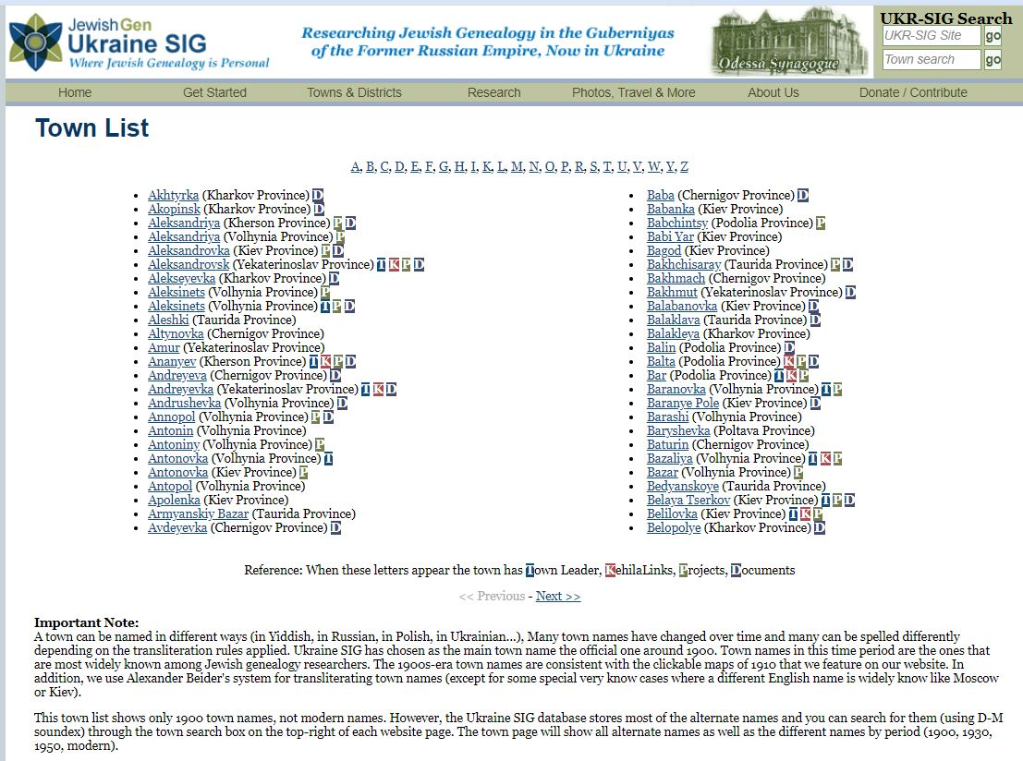
Towns in Ukraine

Slide 11
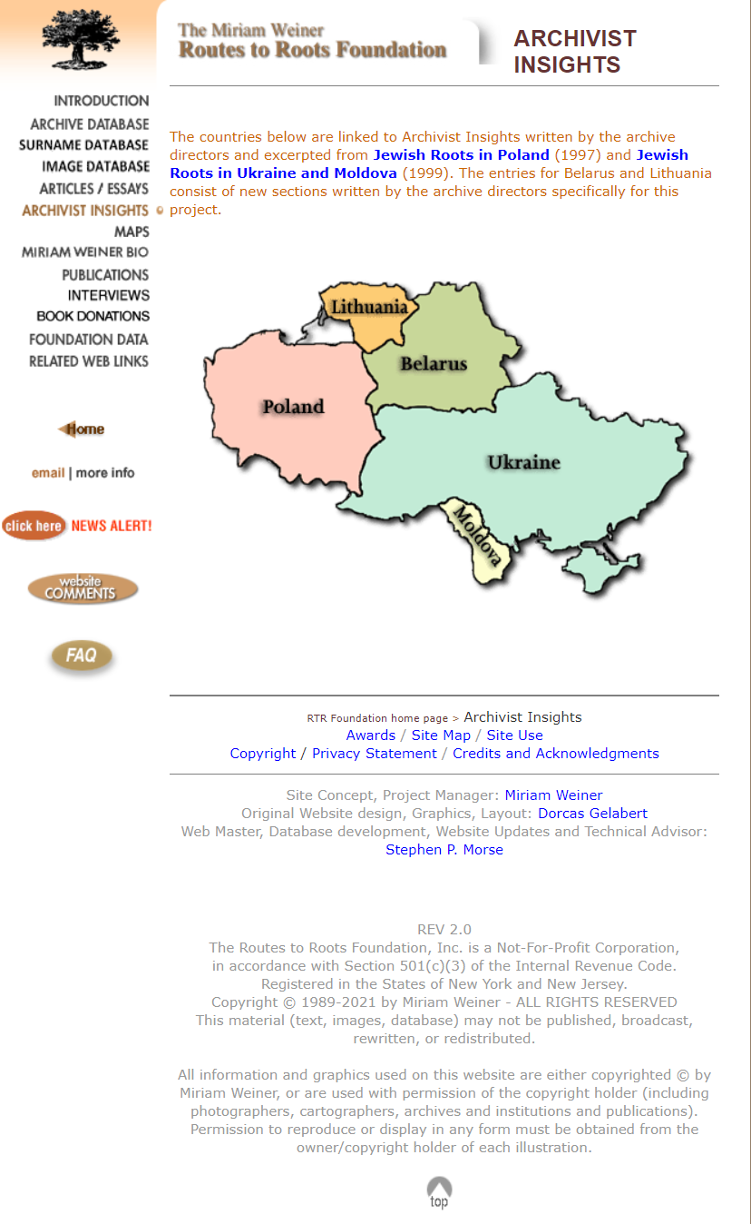
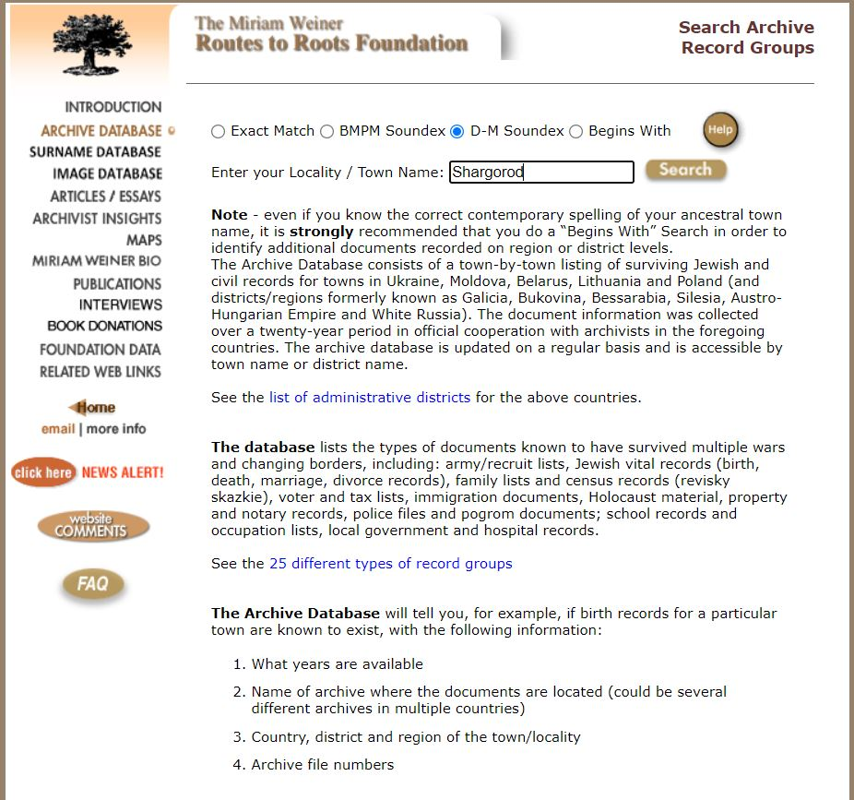
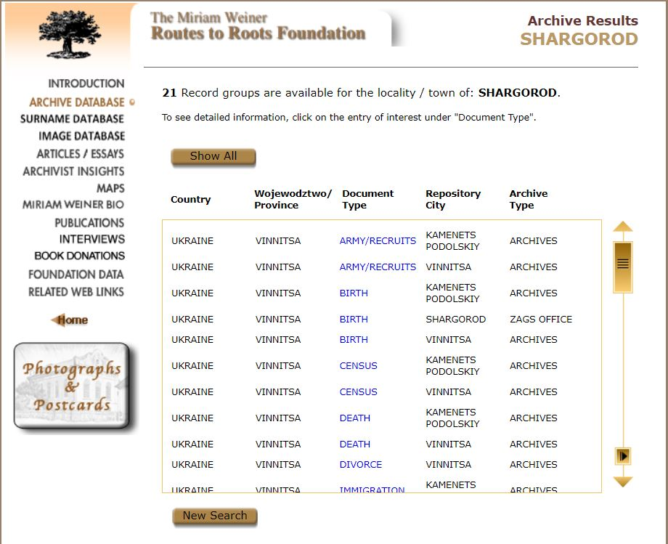
Routes to Roots Foundation Site

Slide 12
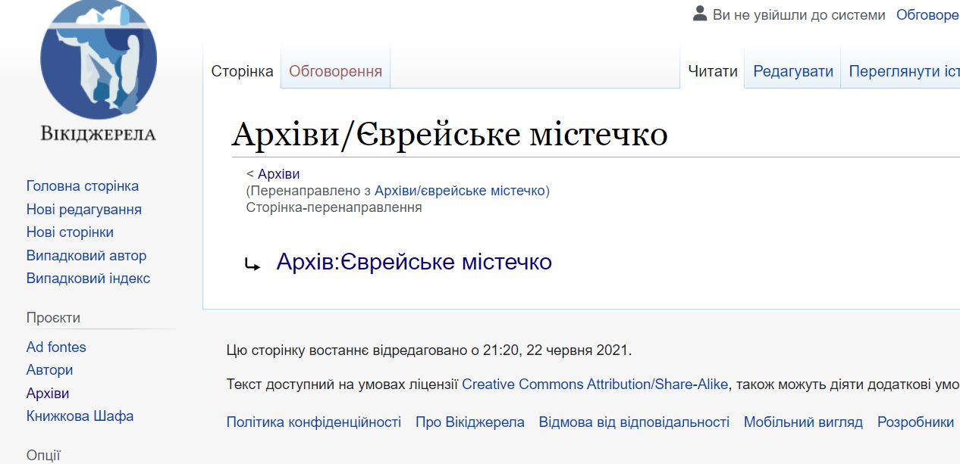
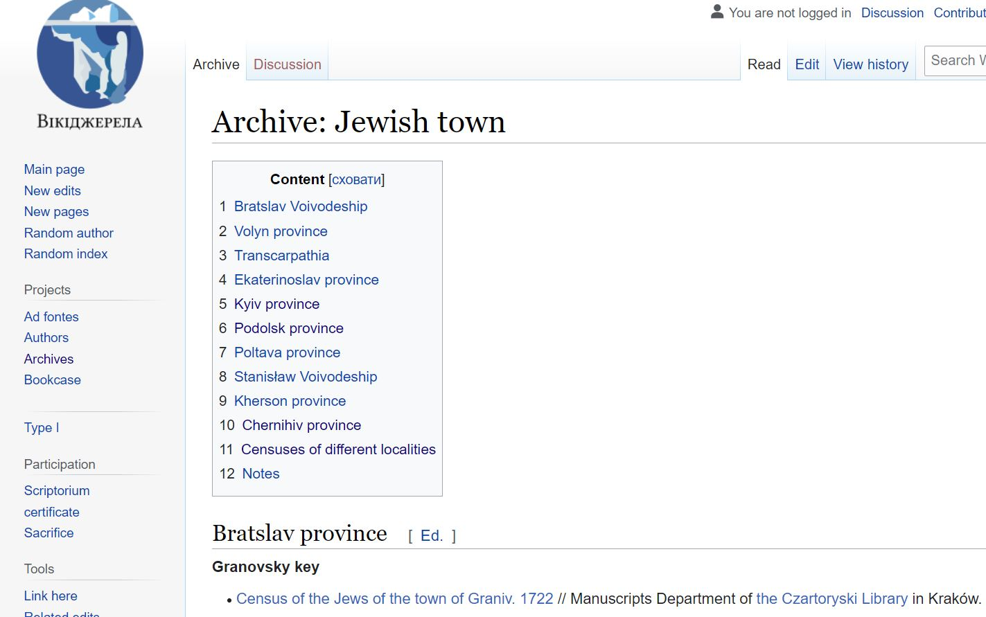
Alex Krakovsky’s
Wiki Site
Use Google
Translate

Slide 13
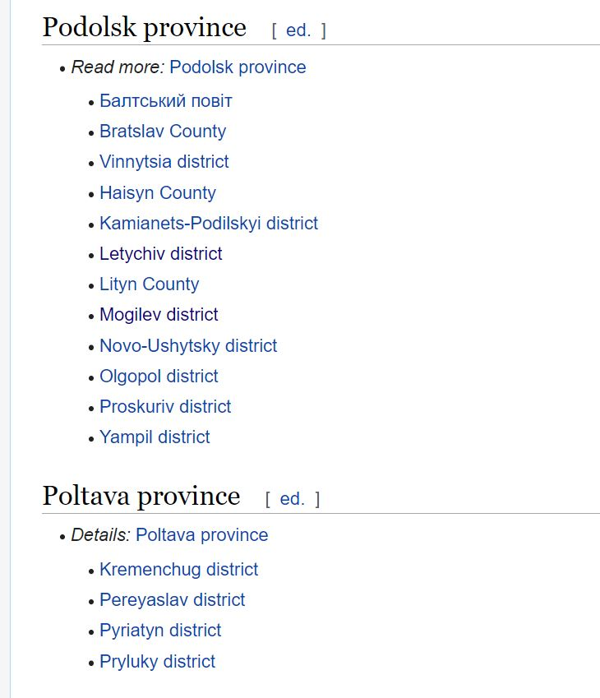
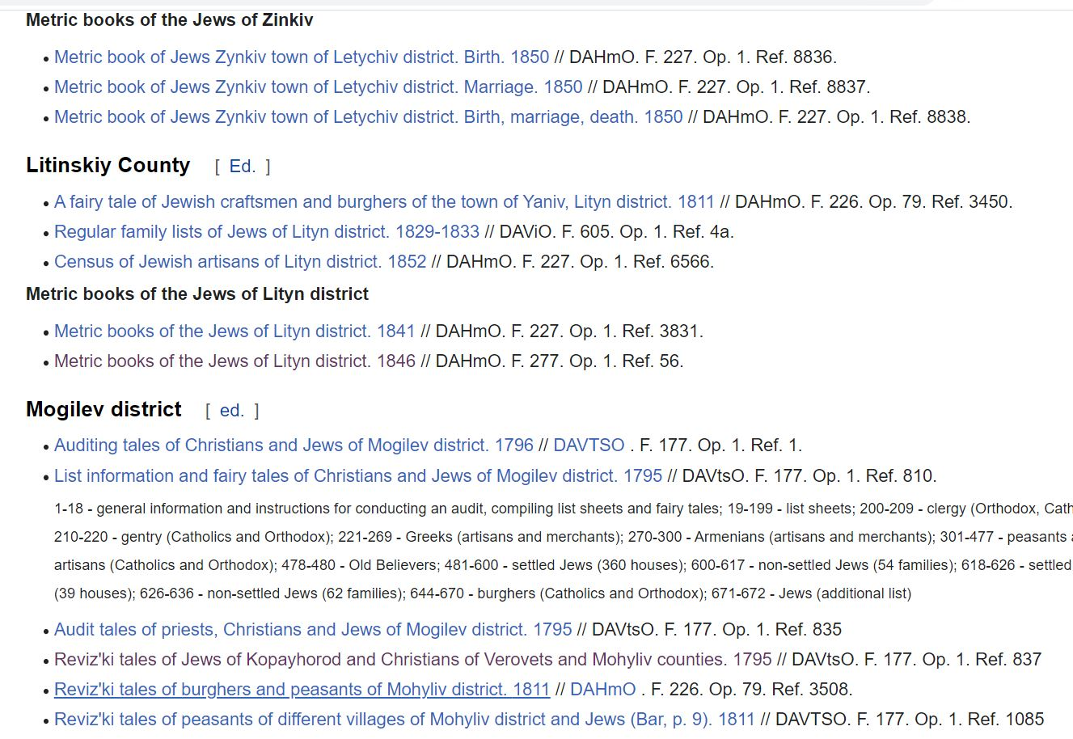

Slide 14
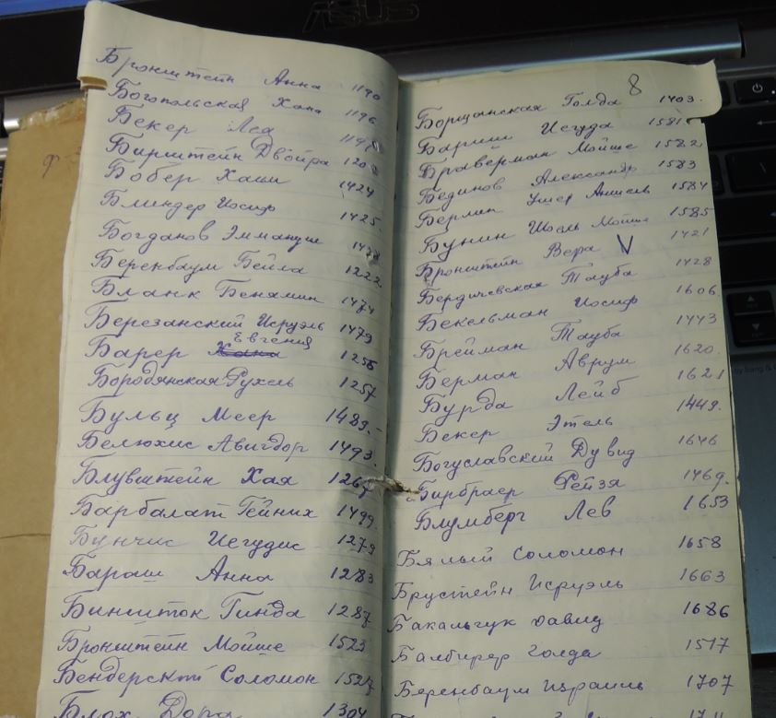
Alpha Index to Odessa
Metrical
Records
19th & 20th
Centuries

Slide 15
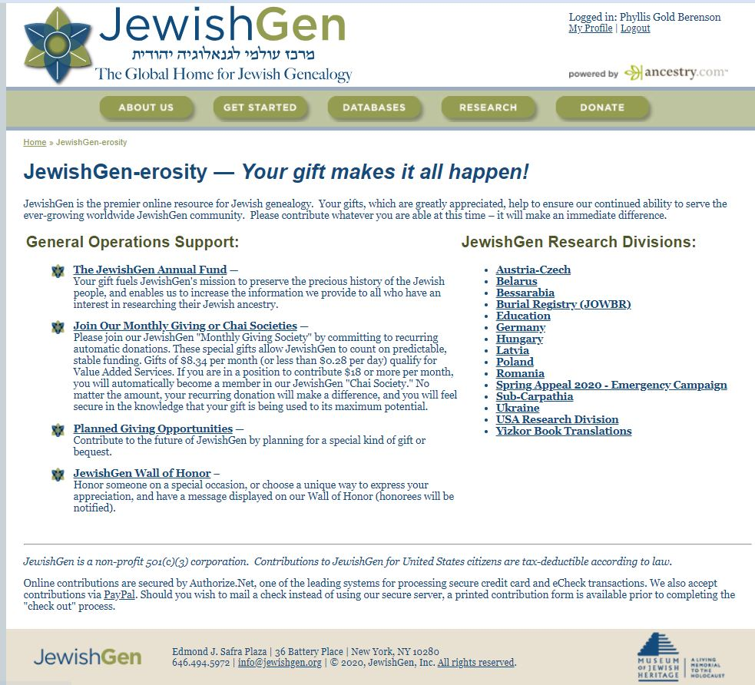

Slide 16
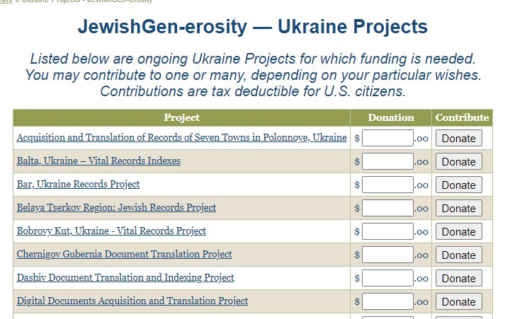
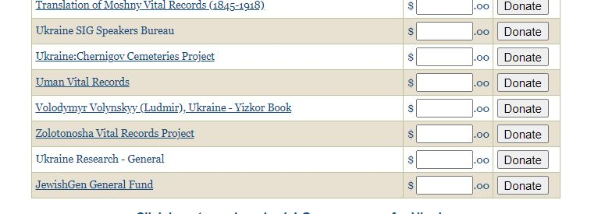

Slide 17
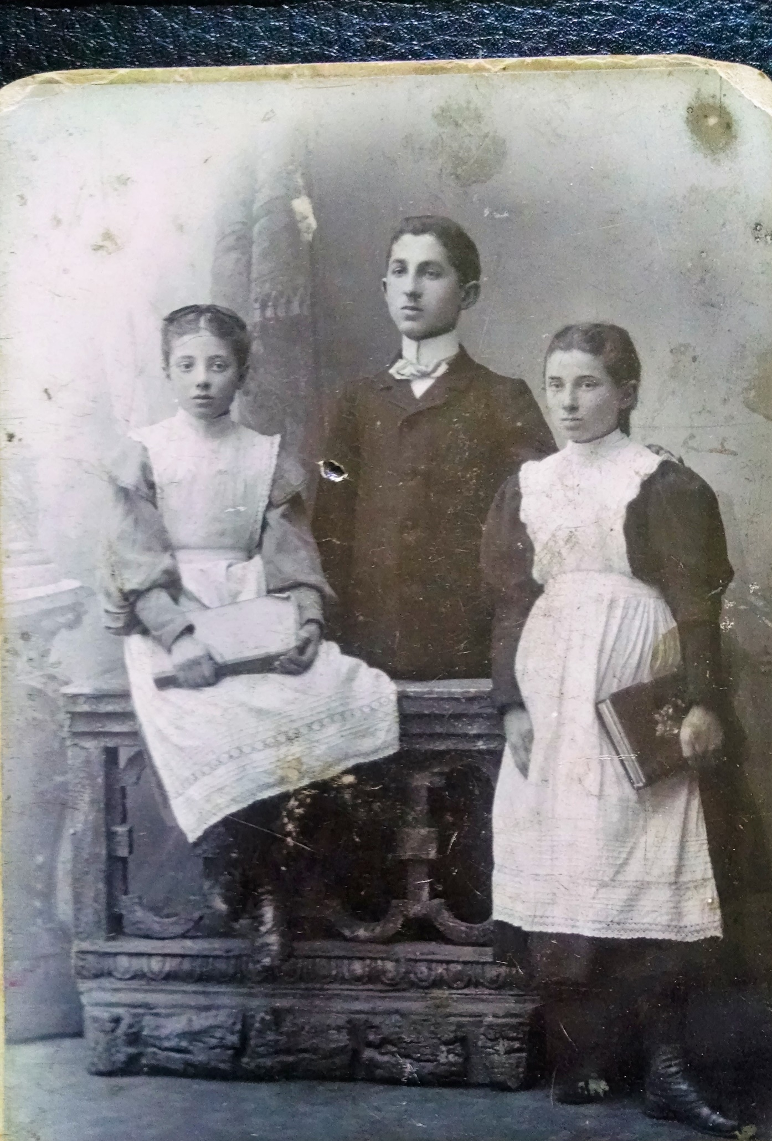
Berenson Children
Mogilev-Podolskiy c. 1906

Slide 18
CONTACT INFO
Towns Director: Chuck Weinstein Chuck1@outlook.com
Ukraine Division Director: Phyllis Berenson PBerenson@jewishgen.org

